Slide 1

Predicting Home Appliance Prices and Ratings
Arshia Ramezani Zahra Jafari

Slide 2
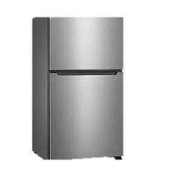
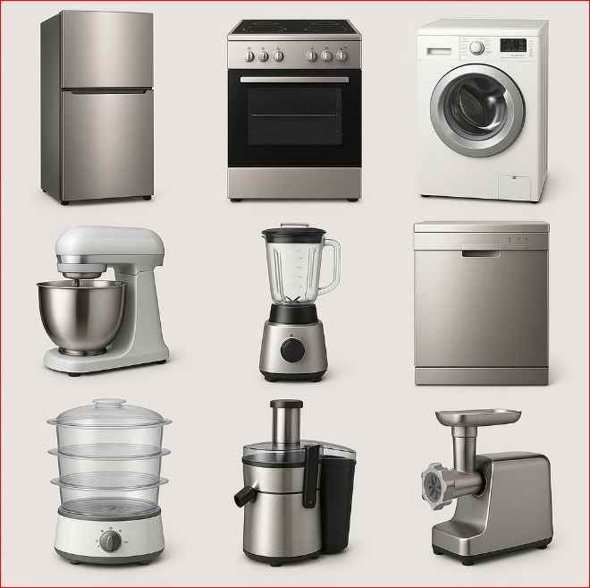
Dataset
Refrigerator
Gas Stove
Washing Machine
Dishwasher
Juicer
Mixer
Air Fryer
Meat Grinder

Slide 3
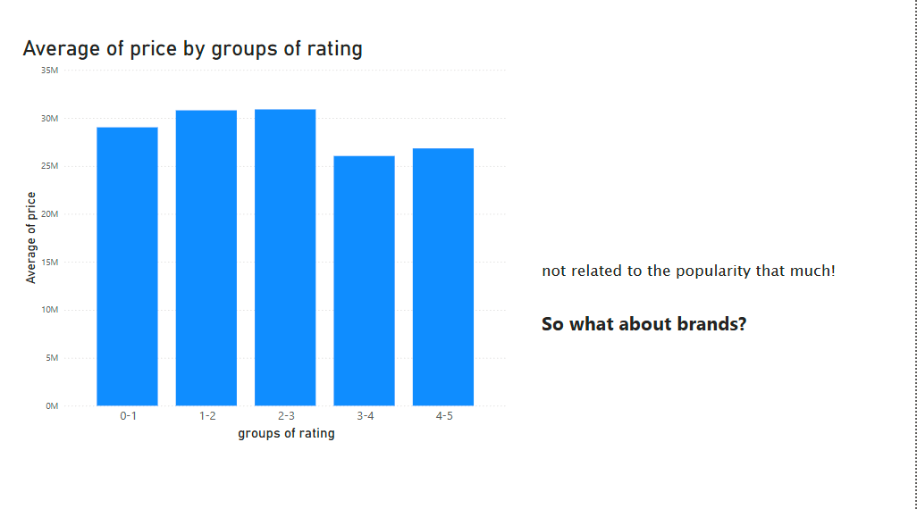
Why?!

Slide 4
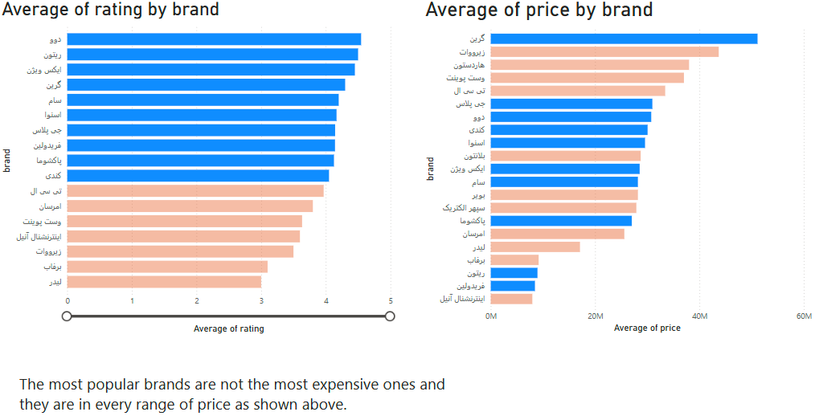

Slide 5
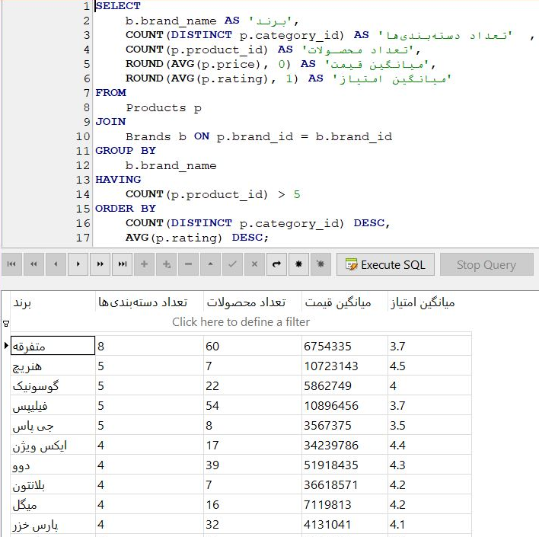

Slide 6
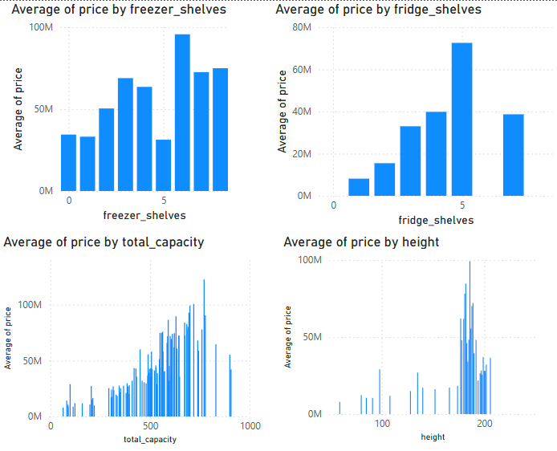
Some Features of Refrigerator vs. Price

Slide 7
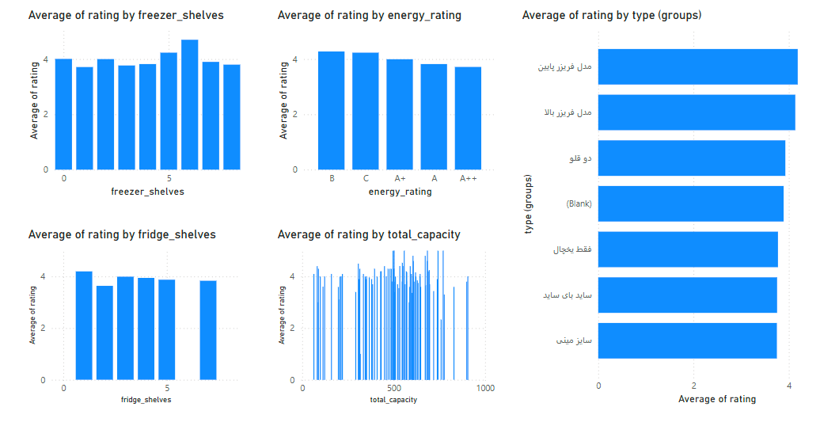
Some Features of Refrigerator vs. Rating

Slide 8
Importance
1
Helps consumers identify fair pricing
2
Assists sellers in competitive pricing strategies
3
Guides manufacturers make what’s more popular

Slide 9
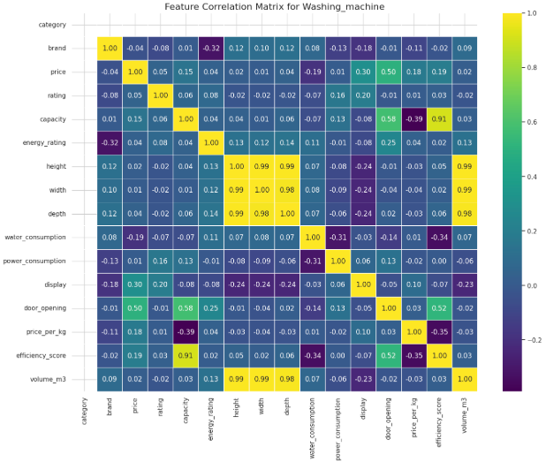
Washing Machine

Slide 10
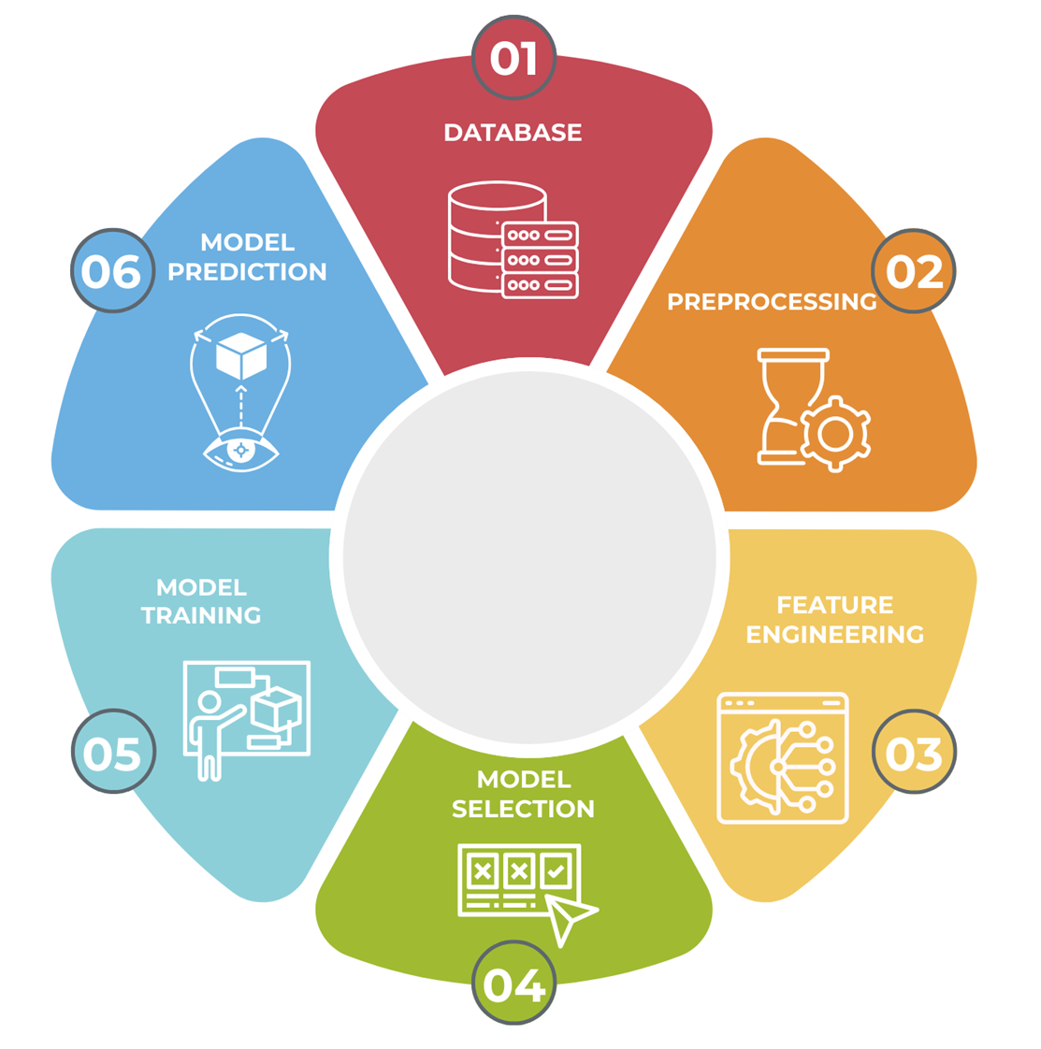

Slide 11



Models

Slide 12



Metrics
RMSE
R2
MAE

Slide 13
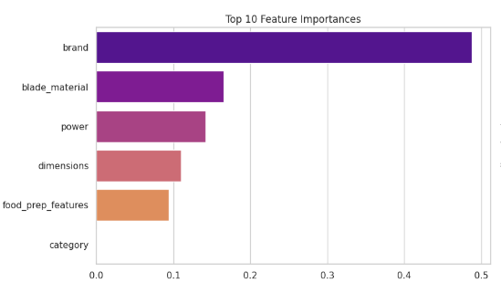
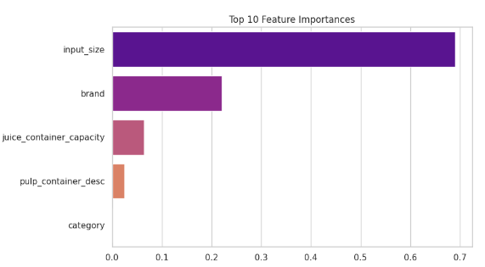
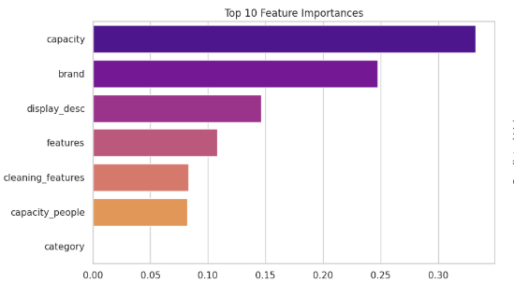
Meat Grinder
Juicer
Air Fryer

Slide 14
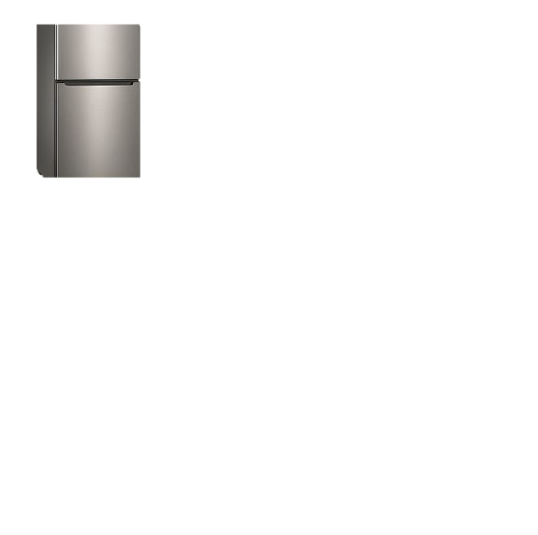
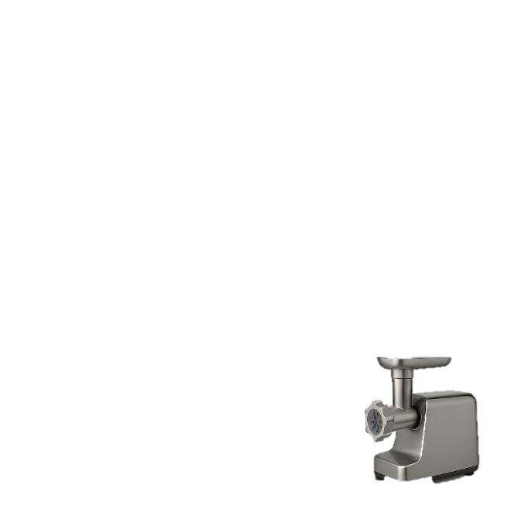
Best Prediction
Worst Prediction
R2: 0.92
RMSE: 40M
MAE: 49 M
R2: 0.15
RMSE: 10M
MAE: 8M

Slide 15
Thank you

